Slide 1

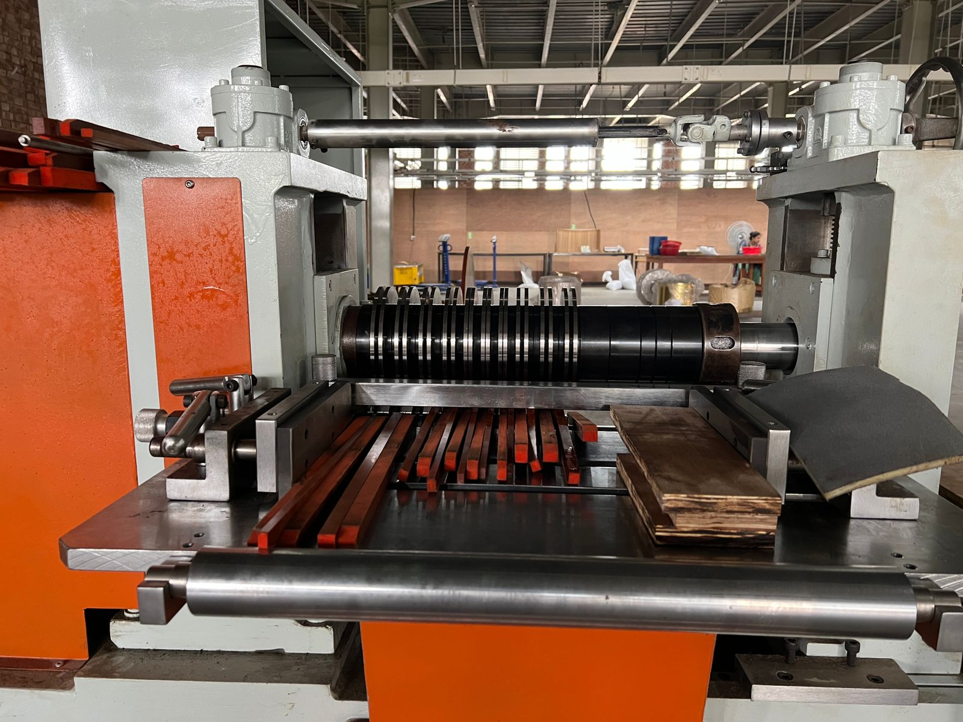
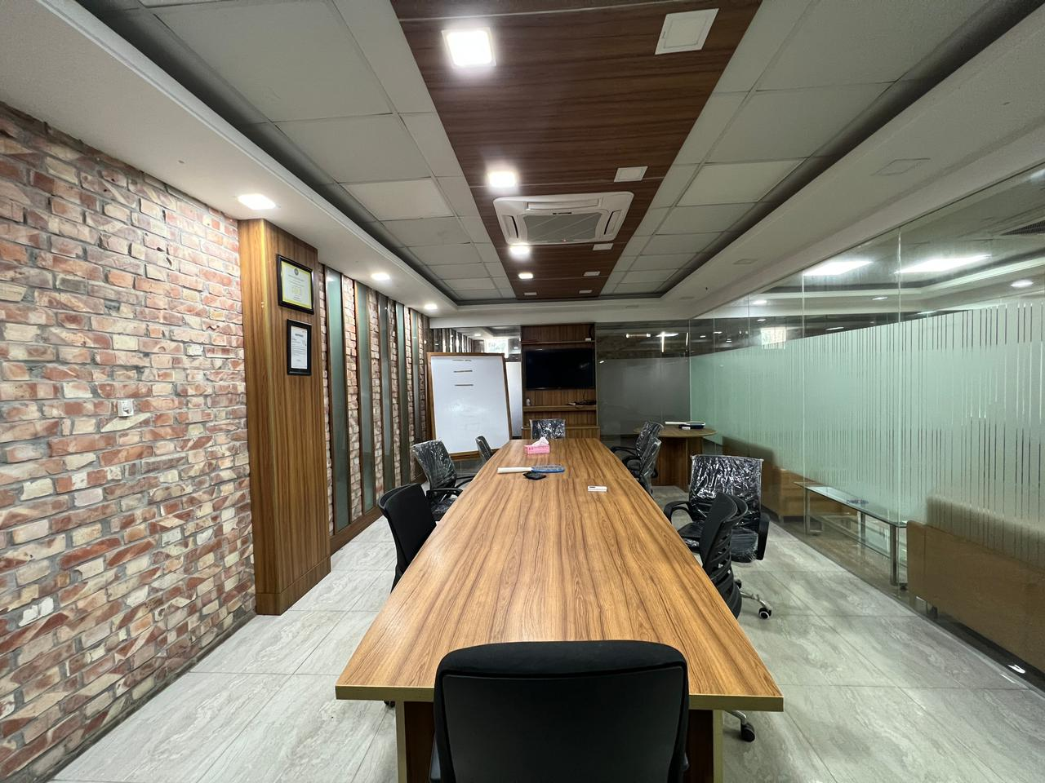
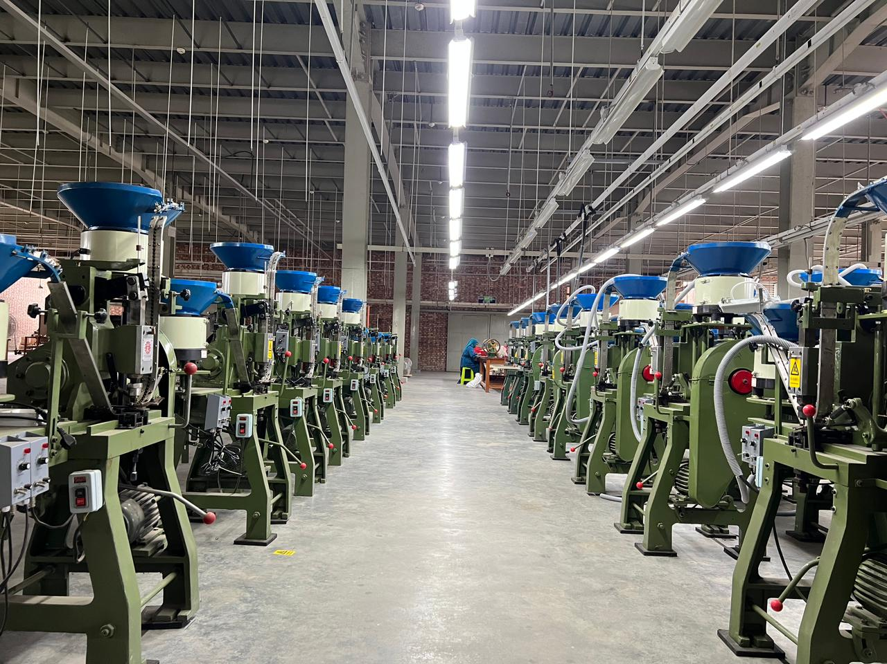
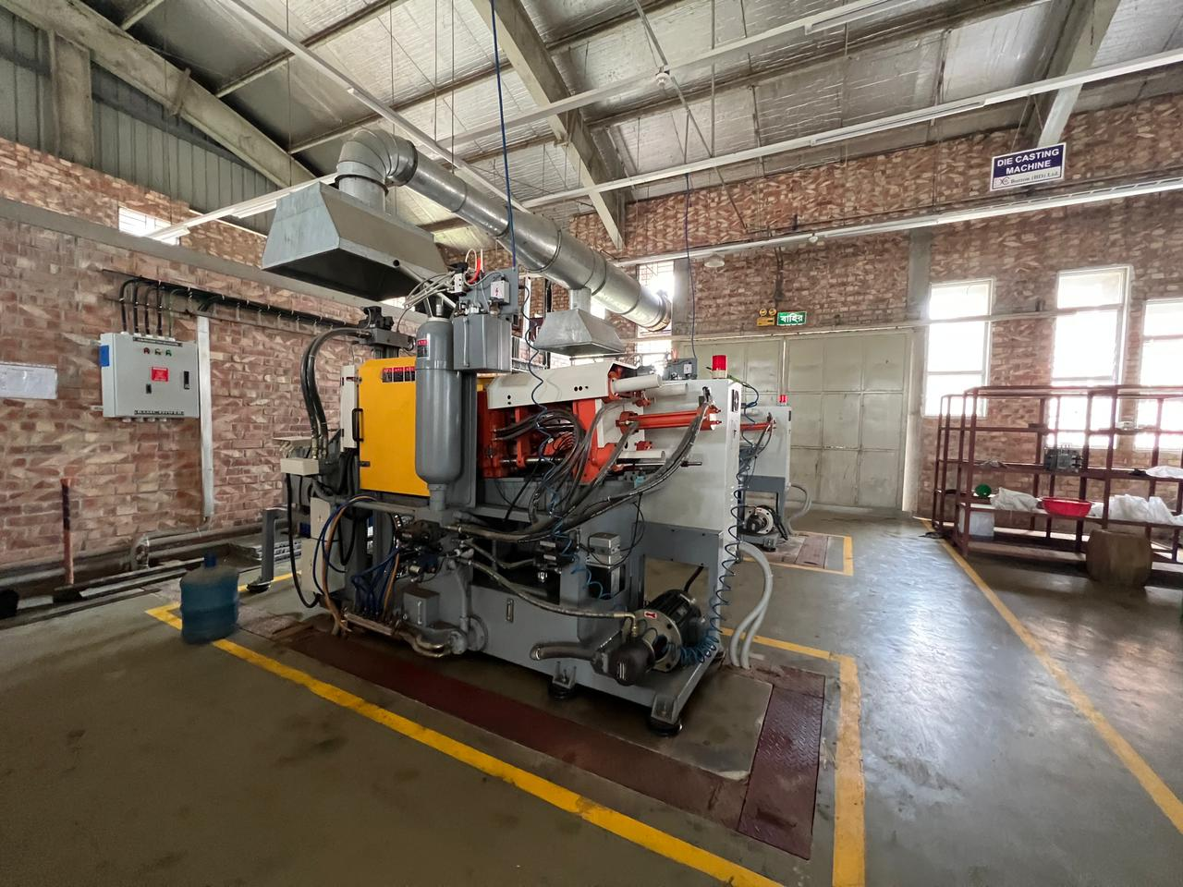
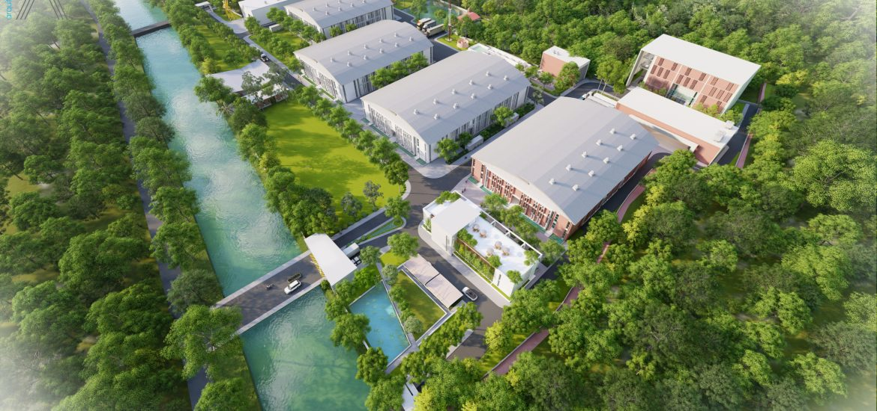
BUSINESS
LEED CERTIFIED
GOLD FACTORY
PROFILE

Slide 2
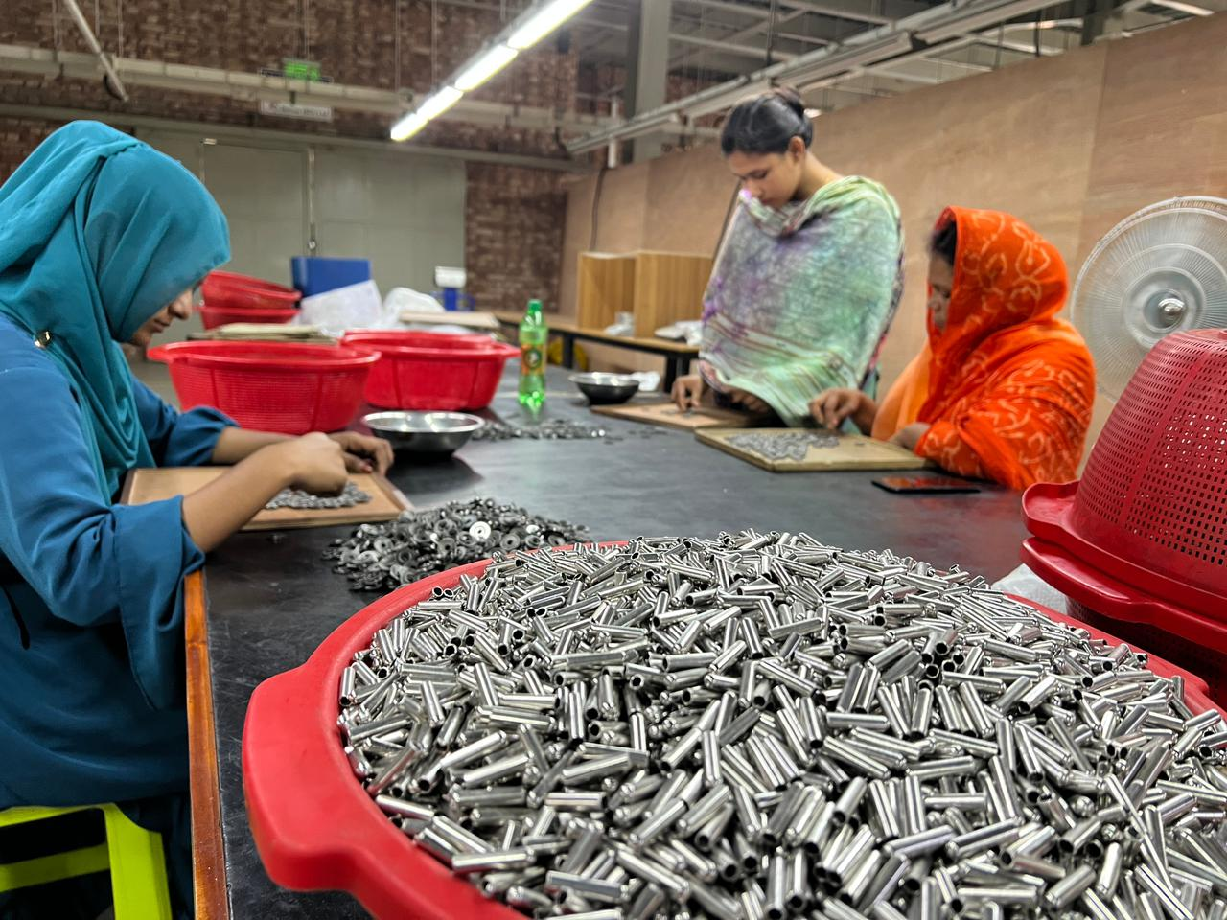
01
BUTTON
UNIT

Slide 3
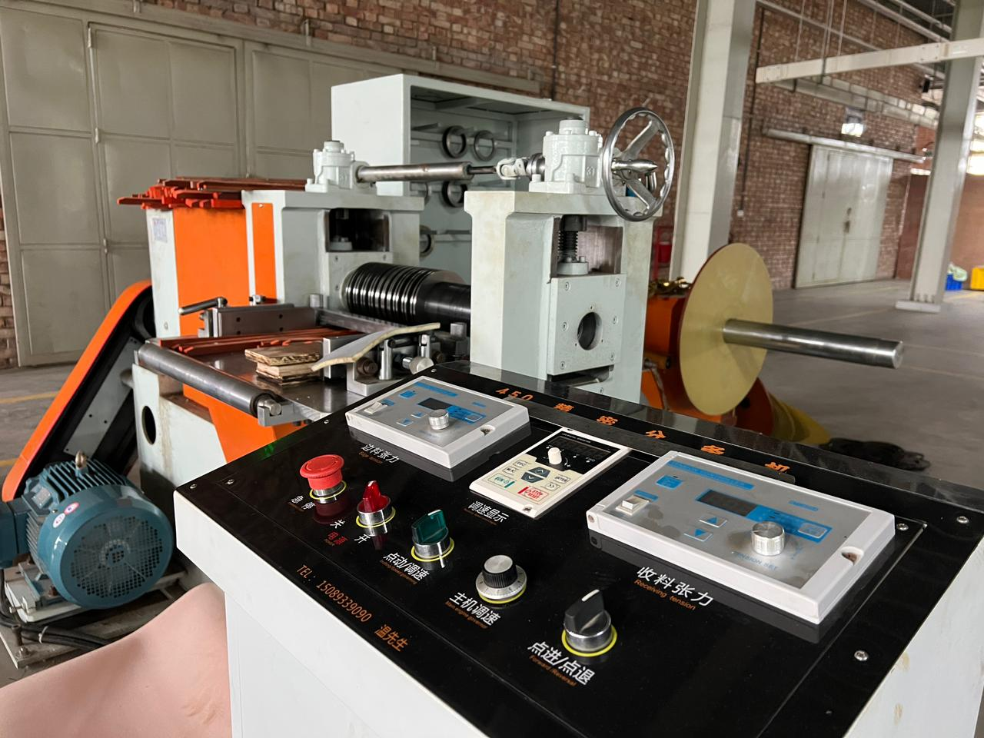
02
Machine name | Machine pressure | Number of machines | Number of molds | Output per hour | 8-hour output Per-Machine | Total Production Capacity
Automatic punch (Top) | 1500 T | 2 | 1 out of 1 | 4500 | 36000 | 72000
Automatic punch (Top) | 2000 T | 3 | 1 out of 1 | 4500 | 36000 | 108000
Automatic punch (Top) | 3000 T | 1 | 1 out of 1 | 4500 | 36000 | 36000
Stamping (Bottom) | 1500 T | 4 | 1 out of 1 | 4500 | 36000 | 144000
Stamping (Bottom) | 2000 T | 4 | 1 out of 1 | 4500 | 36000 | 144000
Stamping (Bottom) | 3000 T | 4 | 1 out of 1 | 4500 | 36000 | 144000
Die Casting Machine | 50T | 2 | 12 out of 12 | 7800 | 62400 | 124800
MACHINE LIST

Slide 4
03
Machine Name | Machine Specification | Per Hour | 8 hour
Assembly | (14,15,16,17,18,19,20)MM Shank Button | 31500 | 252000
Assembly | (14,15,16,17,18,19,20)MM Middle Hole Button | 31500 | 252000
Assembly | (6,7,8,9,9.5) MM Nipple UP | 27,000 | 216,000
Assembly | (12.5,14,15,16,17,18)MM Snap | 27,000 | 216,000
Finish item for snap | Curling machine (2,B,C,3,B,C,1,B,C) | 27,000 | 216,000
MACHINE LIST

Slide 5
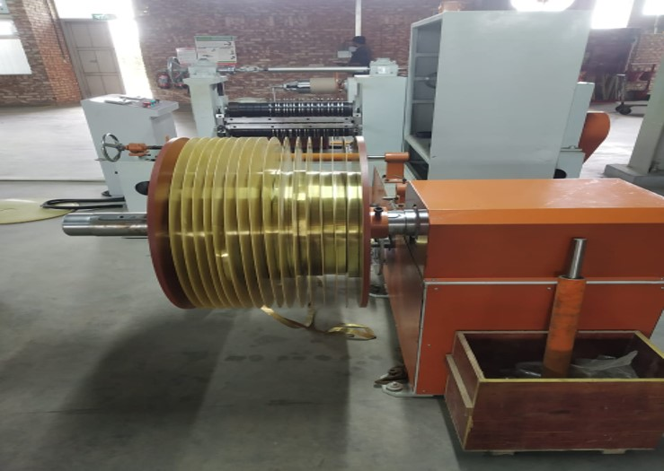
04
Per –Day Capacity 6 Ton
COPPER
SLITTING MACHINE

Slide 6
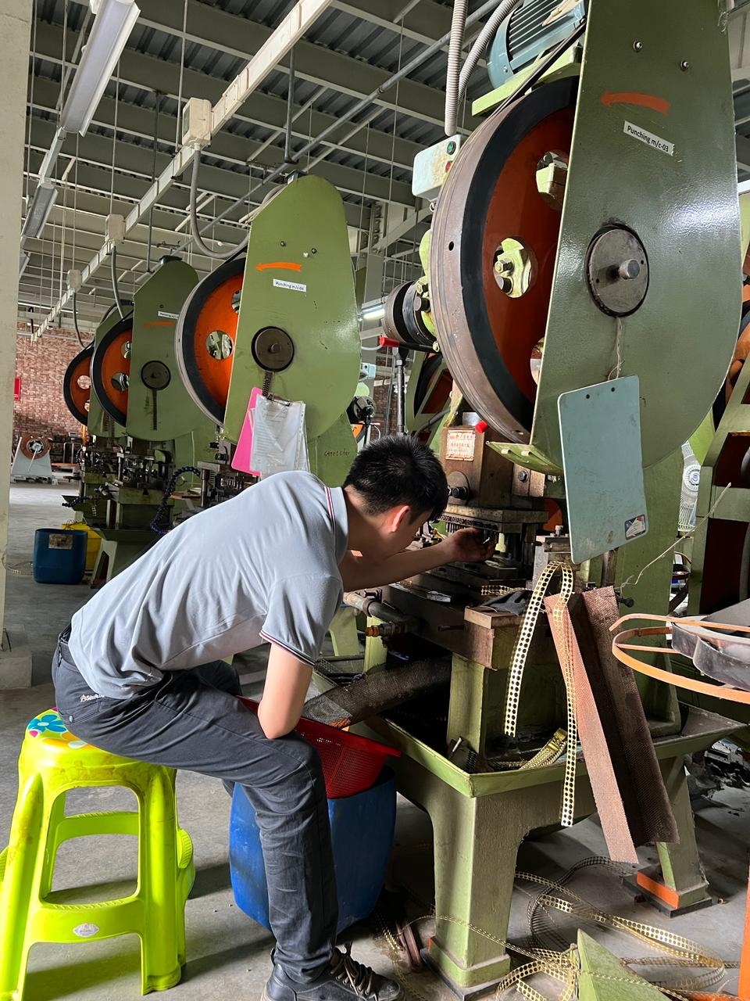
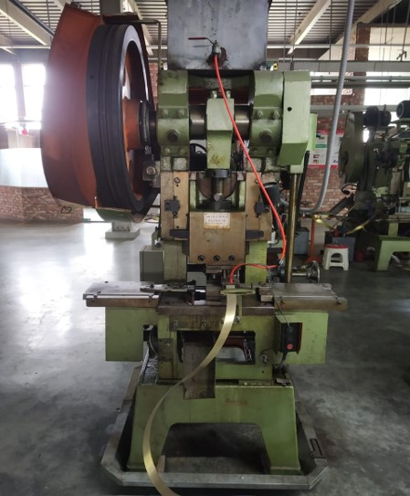
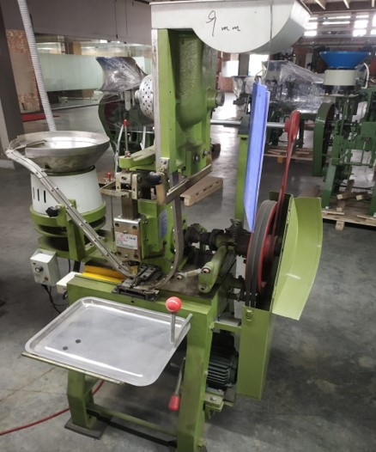
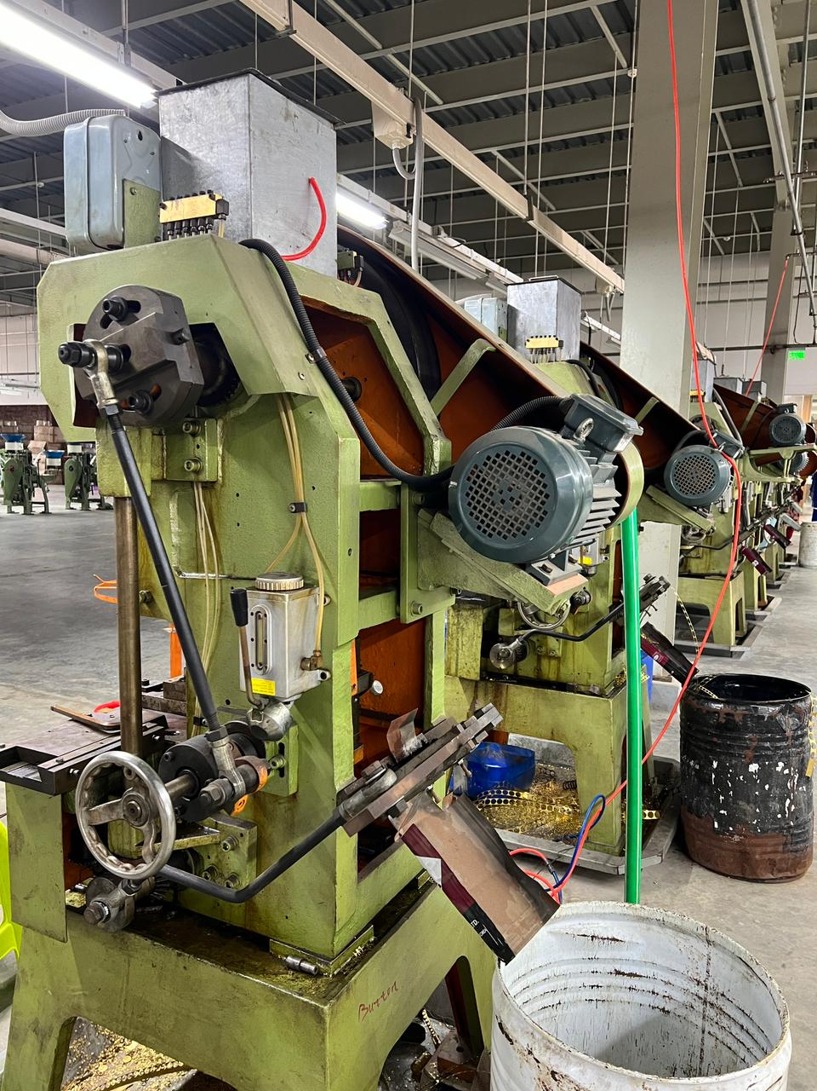
05
AUTOMATIC PUNCH
Per –Day Capacity 3750 GROSS

Slide 7
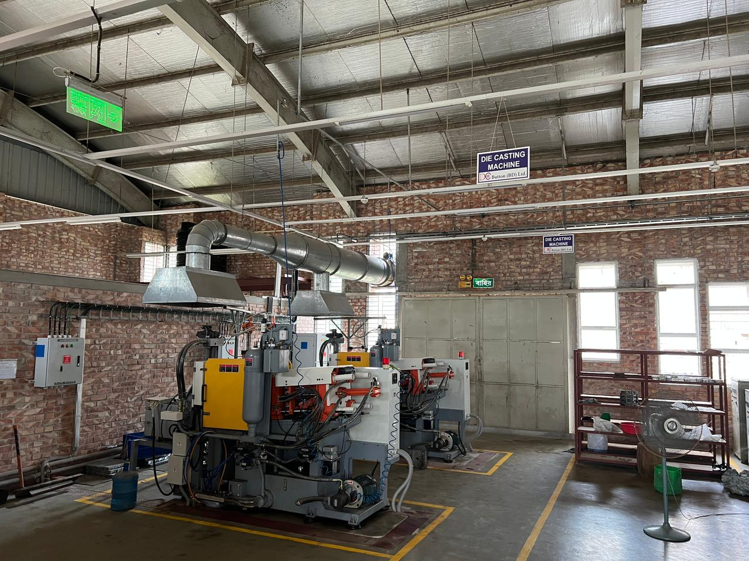
06
DIE CASTING
MACHINE
Per –Day Capacity 2100 GROSS

Slide 8
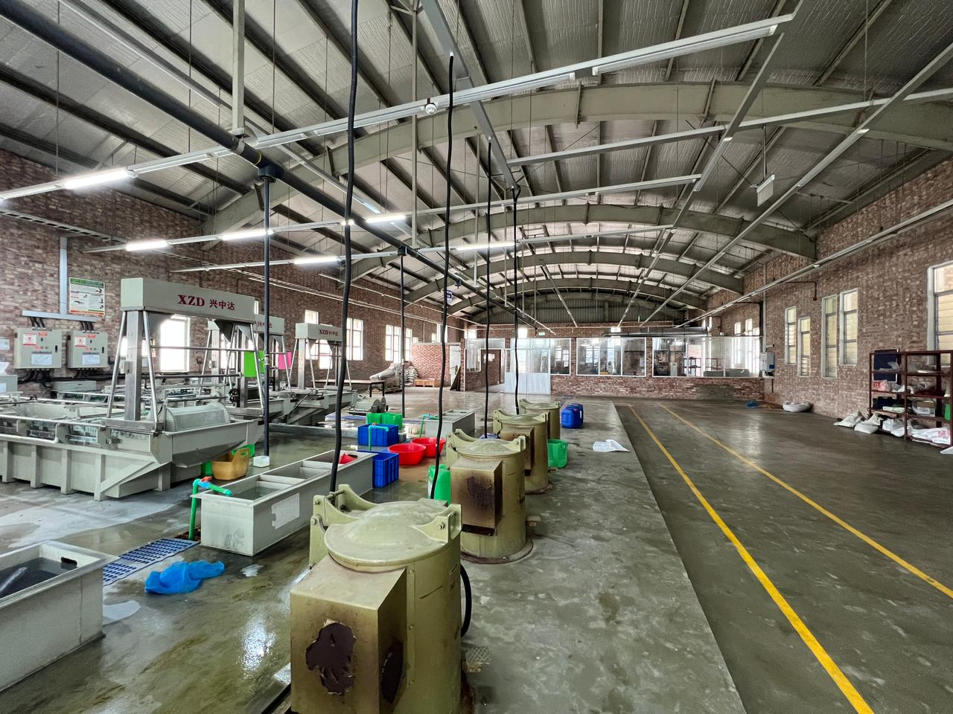
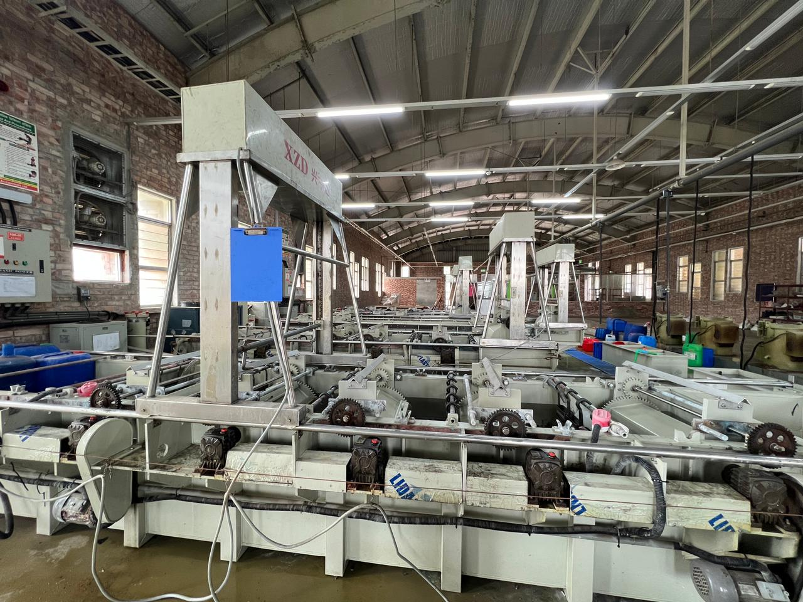
07
ELECTROPLATING
Per –Day Capacity 14000 GROSS

Slide 9
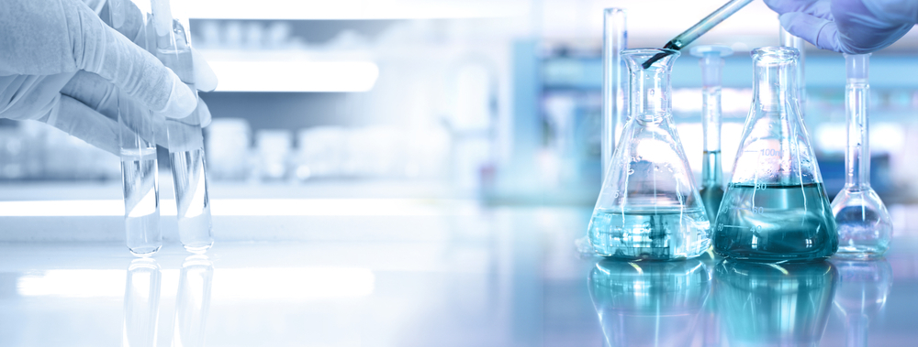
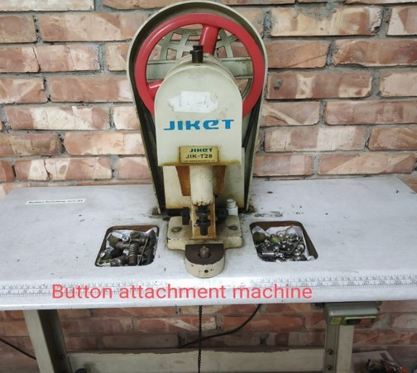
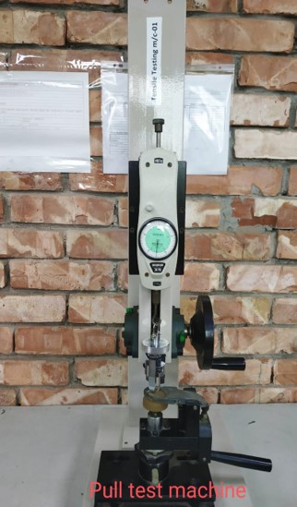
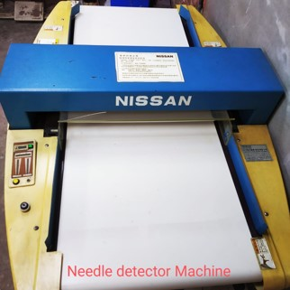
08
PHYSICAL LAB

Slide 10
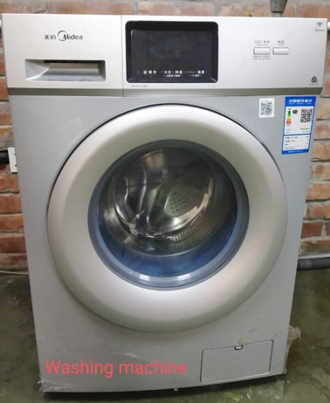
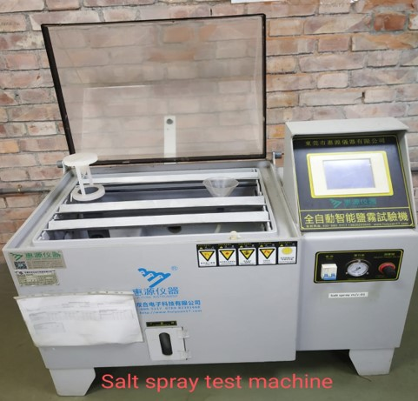
09
WET LAB

Slide 11
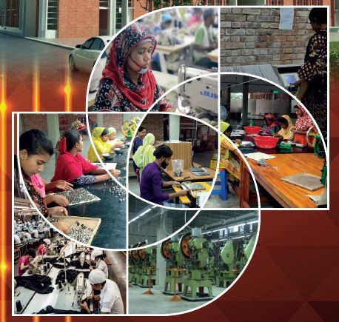
10
FURNISHING AND QC

Slide 12
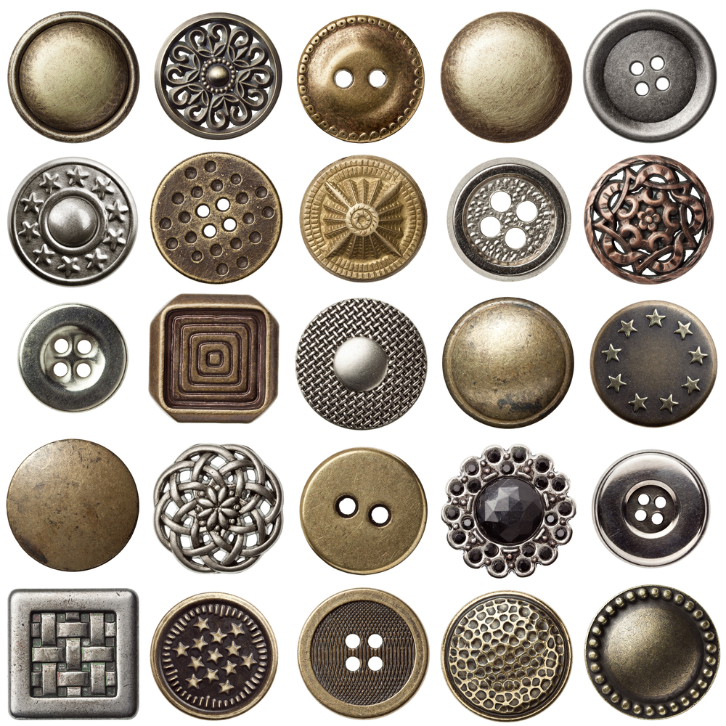
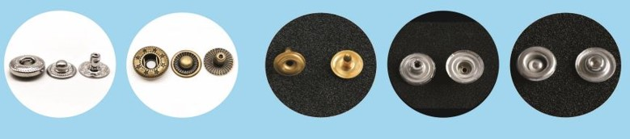
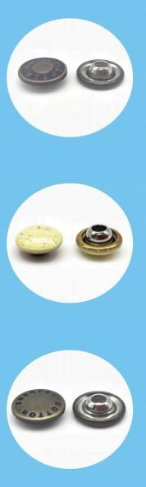
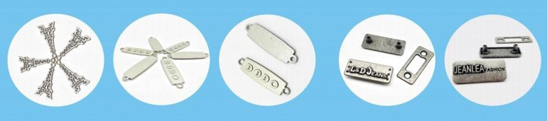
11
OUR PRODUCTS

Slide 13
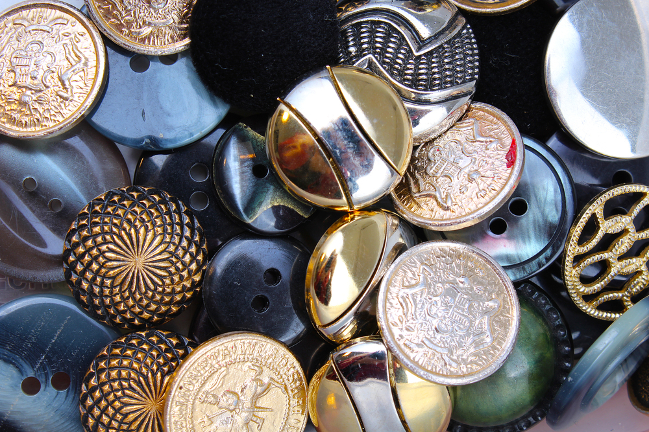
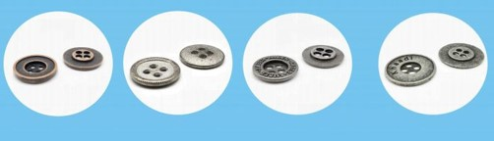
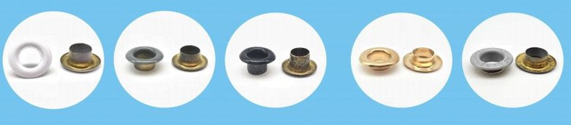
12
OUR PRODUCTS

Slide 14
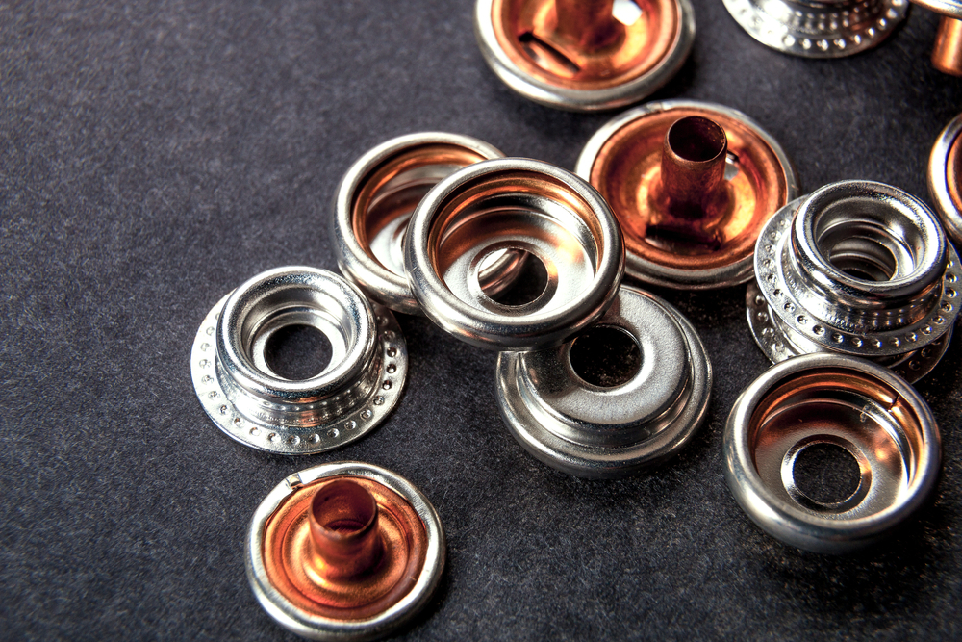
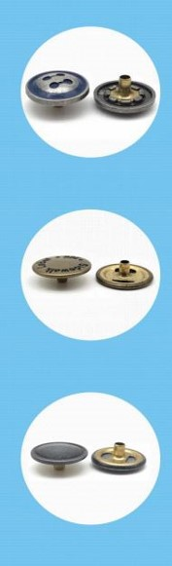
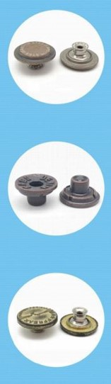
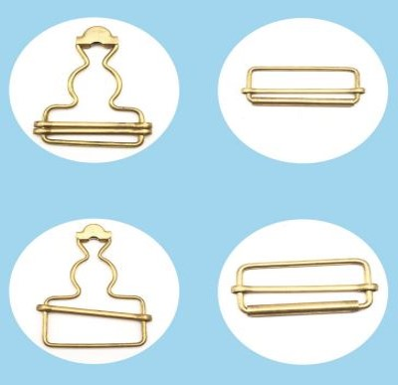
13
OUR PRODUCTS

Slide 15
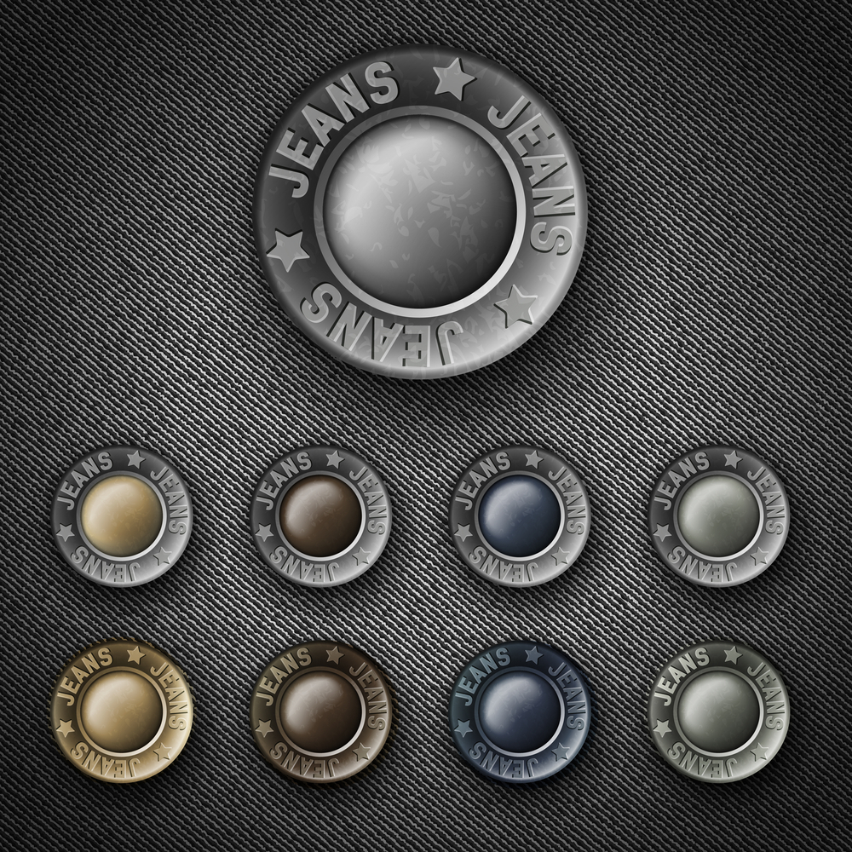
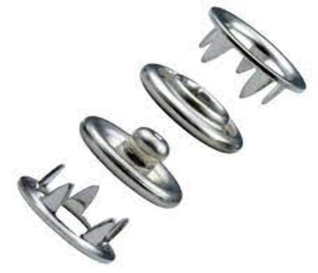
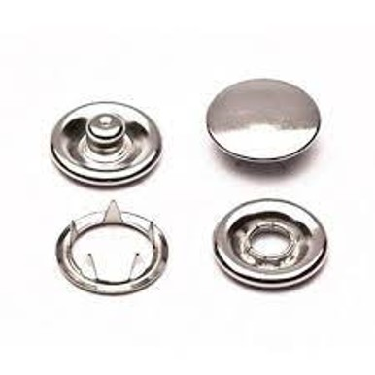
14
Per day capacity
will be 800 Gross
OUR PRODUCTS

Slide 16
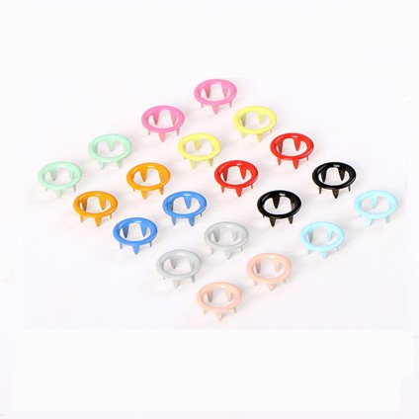
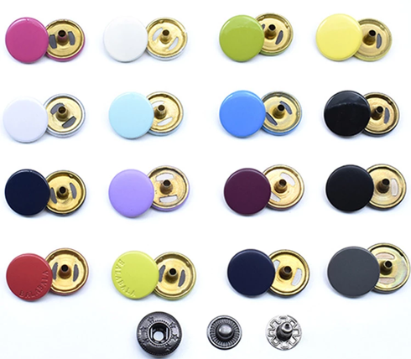
15
DTM & SPRAY
OUR PRODUCTS

Slide 17
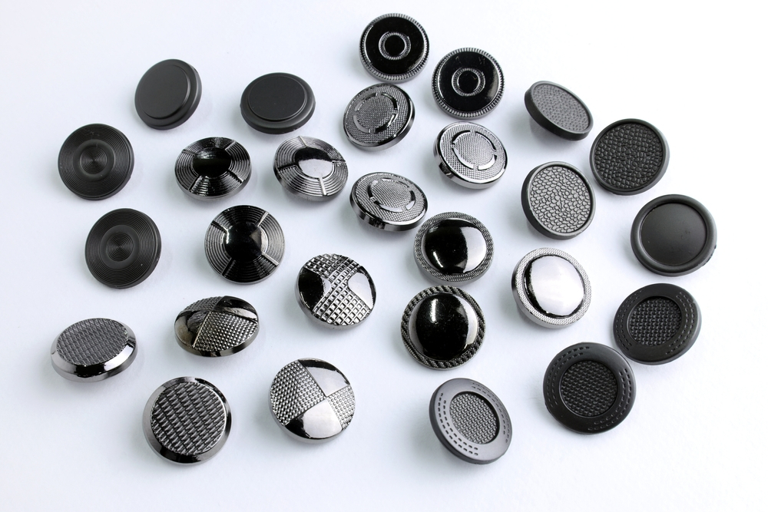
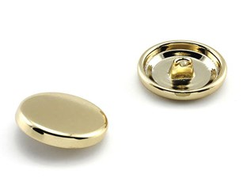
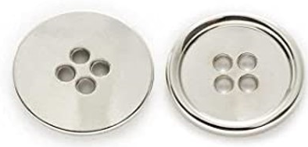
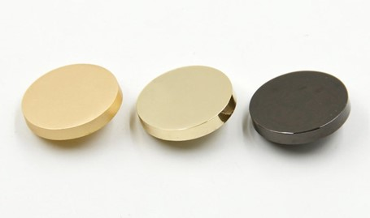
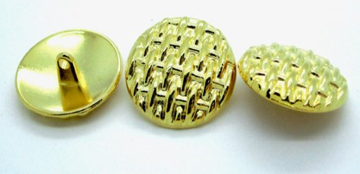
16
UPCOMING PRODUCTS

Slide 18
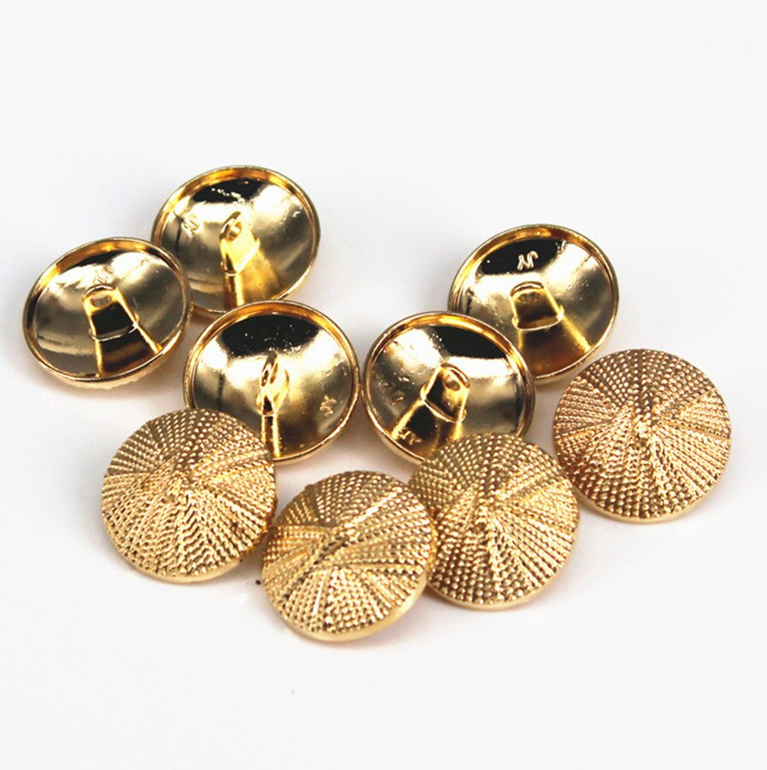
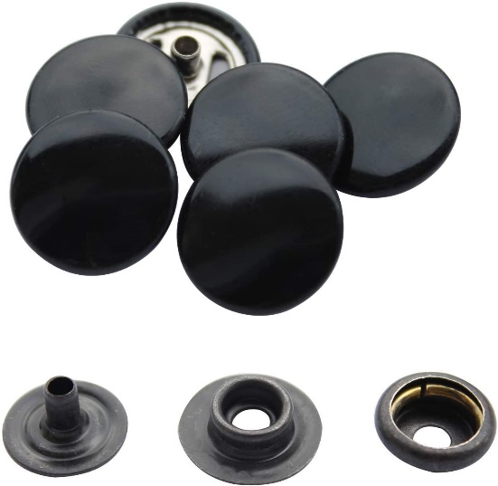
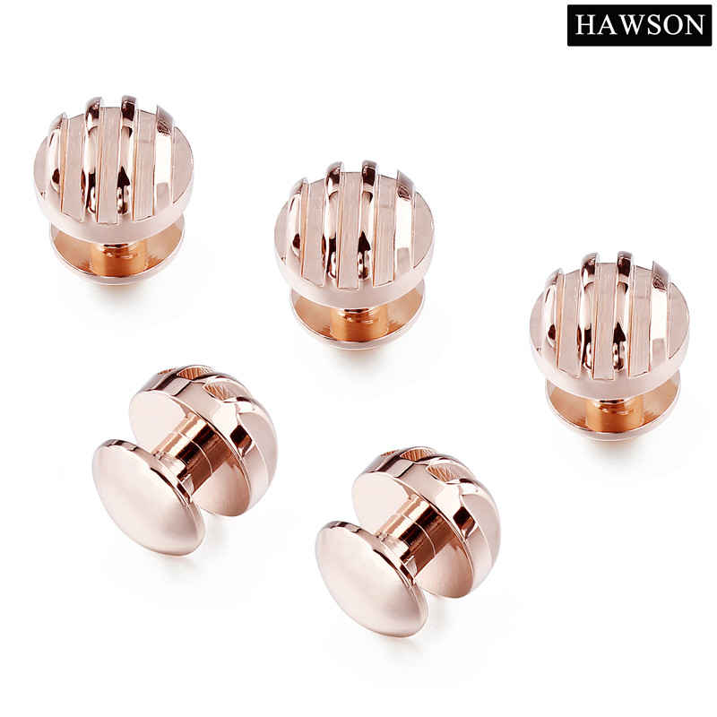
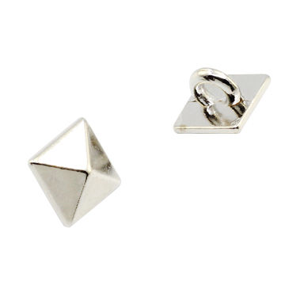
17
UPCOMING PRODUCTS

Slide 19
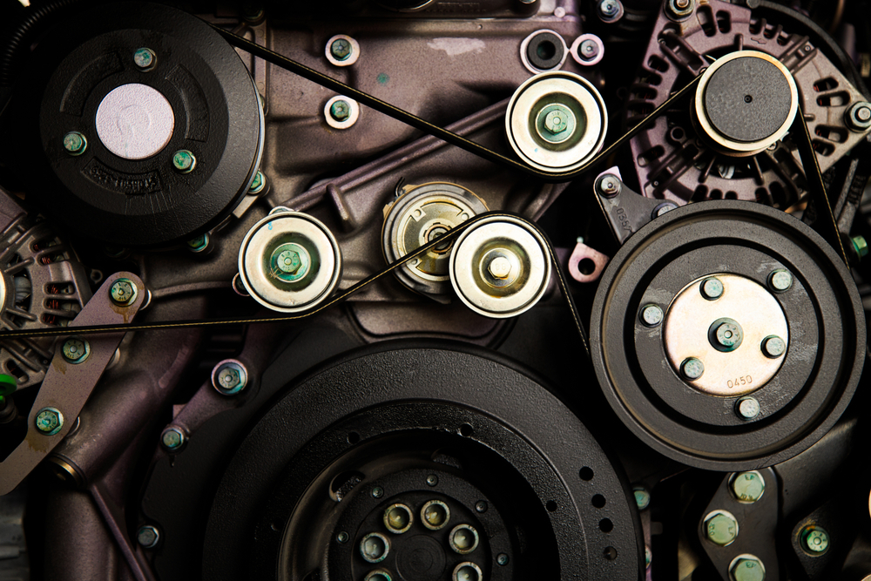
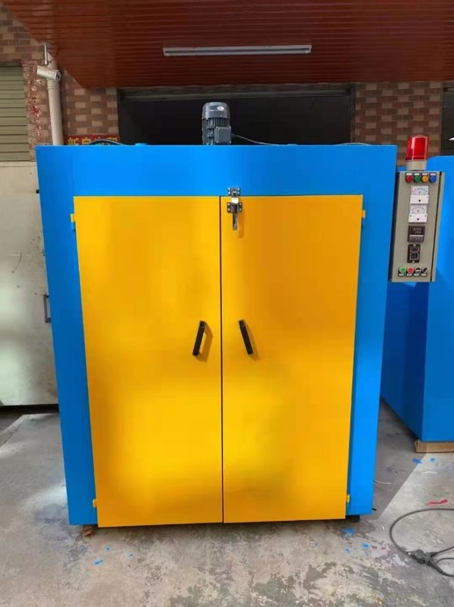
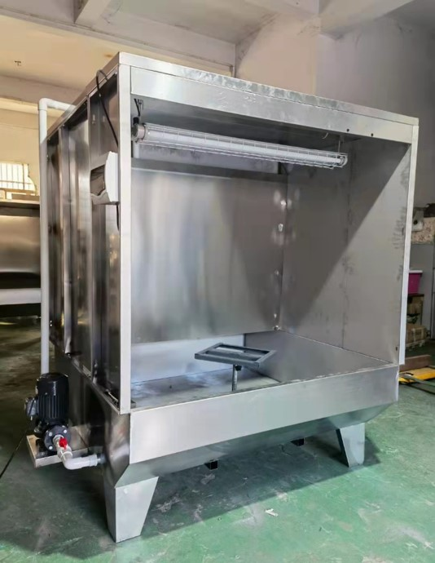
18
DTM PLANT & SPRAY COATING
OUR PROJECT

Slide 20


19
UPCOMING PROJECT

Slide 21
20
Maheen Accessories Ltd. Is a Leads gold certified green concept factory set up in Dashergoan, Lakhonkhola, Bandar, Narayangonj area. Completely a modern setup within 5,600 SQM. Constructed with water recycle unit (ETP), Design into a green-certified building which has gathered gold certification from the LEEDS certification by the US Green Building Certification Council Inc. Phase I of this project has been planned to produce 50,000 gross capacity. Which will Grow to 100,000 Grosses with its phase II. This plant is geared up to give a faster lead time for the customers with the Chinese expertise technicians to maintain the quality standard Maheen Accessories Ltd. Will service their customers with a dedicated customer service team is supported by ERP system where order tracing and customer service level will at a high grade
Environmental Sustainability
Social Sustainability
Energy Efficiency
Water Stewardship
Waste Management
Emissions
Health & Safety
Wages & Compensation
Diversity, Equity & Inclusion
Working Hours
Social Engagement.
SUSTAINABLE
INITIATIVE

Slide 22



21
CERTIFICATION

Slide 23
22
THANK YOU
FOR YOUR ATTENTION.

